Slide 1
Facial Emotions recognition
Presented by:
Gourav Sharma(17BCS1006)

Slide 2
Where can you find Facial Emotions recogniton being used?
The world uses facial emotions recognition technology to identify and catch criminals.
The best examples of the facial emotions recognition is that you can now unlock your Smartphone with your face.
Did you know that every time you upload a photo on facebook, the platform uses facial recognition algorithms to identify the people in that image or that certain government around the world use facial emotions recognition technology.
The usage of facial emotions recognition models is only going to increase in the next few years.

Slide 3
About the project! facial emotions recognition:
facial emotions recognition is a method of identifying or verifying the identity of an individual using their face.
This system can be used to identify people in photos, videos , or in real-time as well.
Facial recognition is a category of biometric software that maps an individuals facial feature mathematically and stores the data as a faceprint.
The software uses deep learning algorithms to compare a live capture or digital image to the stored faceprint in order to verify an individual’s identity.

Slide 4

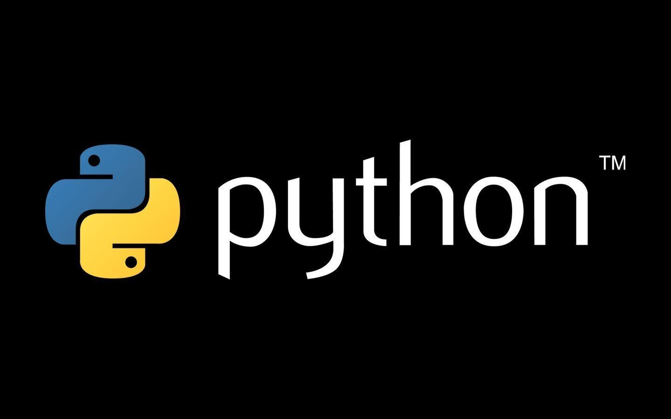
Project is made using:
Python
OpenCV

Slide 5
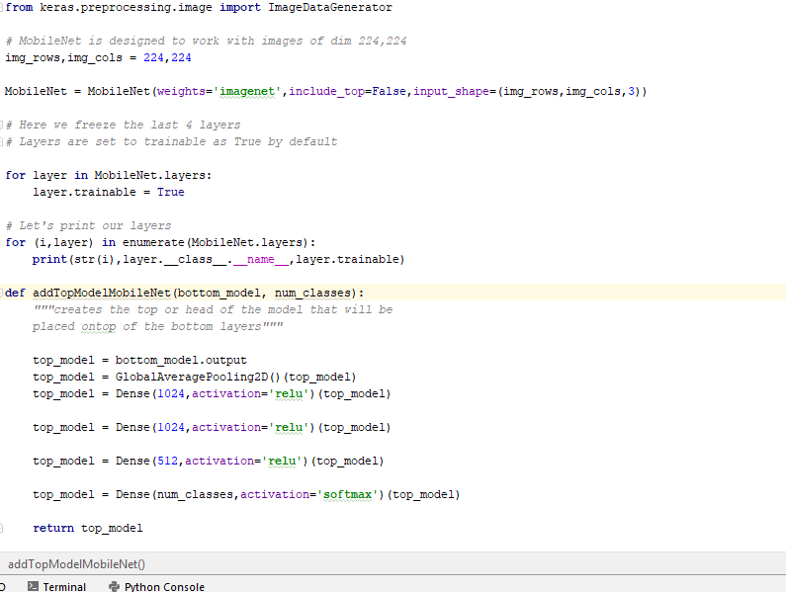
Technologies used:
For facial emotions recognition with Python and opencv , we need two additional libraries which are Dlib and face_recognition.
Install and Import the following:
Import face_recognition
Import os
Import cv2
Import numpy
From time import sleep

Slide 6
About the Libraries used:
DLib
Face recognition
DLib is an open source C++ library implementing a variety of machine learning algorithms, including classification, regression, clustering, data transformation, and structured prediction .
Facial recognition software analyzes video streams and matches the results against previously stored images and information in your database

Slide 7
Further libraries been used:
NumPy
Time and OS
NumPy is a library for the Python programming language, adding support for large, multi-dimensional arrays and matrices, along with a large collection of high-level mathematical functions to operate on these arrays.
time module available in Python which provides functions for working with times, and for converting between representations.
The OS module in Python provides a way of using operating system dependent functionality. The functions that the OS module provides allows you to interface with the underlying operating system that Python is running on – be that Windows, Mac or Linux.Feb

Slide 8
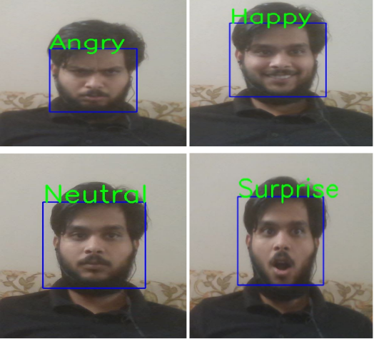
How this recognizes? Main interface in this picture here the project recognizes the face and the identity emotions.

Slide 9
FEATURES OF THE PROJECT:
The project features are as follows:
Watchlist as a service
An airtight matching algorithm
scalability
built in privacy protection.
Predictive analytics
Easy to run and use (Just open cmd, browse to the project folder and run .py file).

Slide 10
Any queries?
Feel free to ask!!!

Slide 11
Thank you!!!

